Slide 1
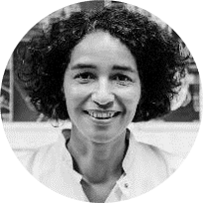




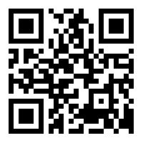




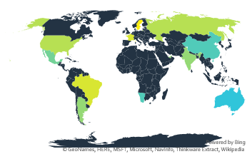
Infographic Resume
Mira Hansson
Full Stack Developer
Database
Email:
mira@contoso.com
Skype
mira.hansson
Website
mirahansson.com
Phone
555-0100
LinkedIn
linkedin.com/in/mirahansson
Expertise
Front-End
Backend
Mission statement
7
Years
Use this to enter information about your experience.
Want to change the image? Right click, choose Fill, then choose Picture.
Short Bio
Software
In this block, put some additional information about yourself, your background, and more about your skills that make you perfect for this job.
Want to adjust your image after changing it? Select the image, go to the Format ribbon (under Picture Tools). Click on the arrow under Crop and choose Fill. Move your image around to position it perfectly.
Live in New York Since 2015
Word
Excel
PowerPoint
Visual Studio
PERSONAL
Education
Remote Projects
On weekends I like spending time with my family.
When I have some time for myself, I enjoy my Xbox and reading science fiction. If I had a hero it would be Shakespeare.
To change icons, follow steps under Education.
2010
School ABC Do a right mouse click on icon.
2012
Studying at ABC Choose Change Graphic from the options.
2012
Studying at ABC
Choose icon from the options and then select icon.
+5
+50
+100
None

